Slide 1

Compiler Design
Preet Kanwal
Department of Computer Science & Engineering
Teaching Assistant : Kavya P K

Slide 2

Compiler Design
Lex Tutorial
Preet Kanwal
Department of Computer Science & Engineering

Slide 3
Compiler Design Lex and Yacc
Lex - reads a specification file containing regular expressions and generates a C routine that performs lexical analysis. Matches sequences that identify tokens.
Yacc - reads a specification file that codifies the grammar of a language and generates a parsing routine.

Slide 4
Compiler Design Lecture Overview
In this lecture, you will learn about:
What is lex and yacc?
Flow of code
How to write a Lex Specification file ?
Example 1 - A simple program
Predefined variables in lex
Example 2 - Prepend Line Numbers
Example 3 - Use of definitions
Example 4 - Word count
Example 5 - Removing Comments
Start conditions
Commonly used Regular expressions in lex specification file
Pseudocode for loop-switch implementation

Slide 5
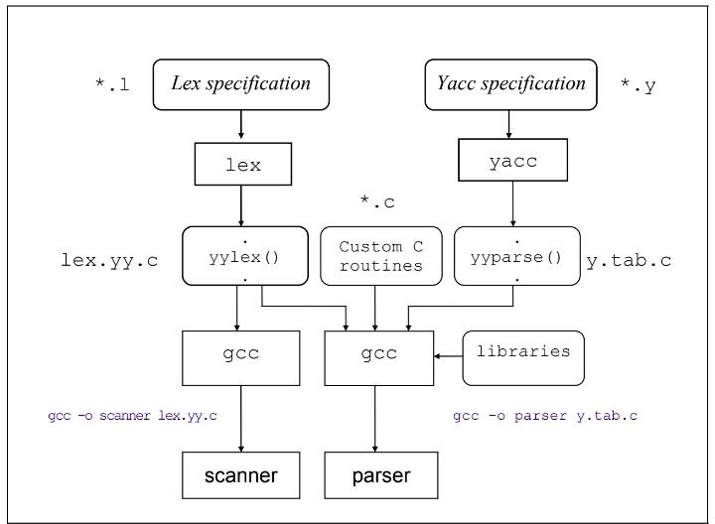
Compiler Design
Flow of code - using lex and yacc tools

Slide 6
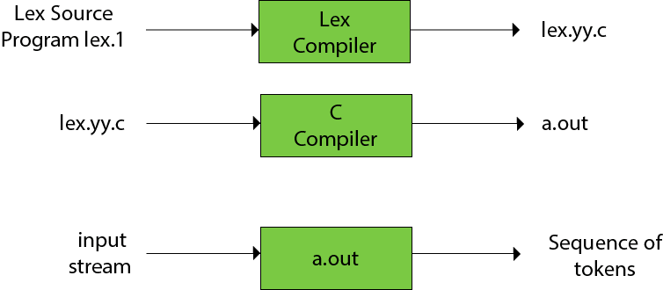
Compiler Design
How to write a Lex Specification file (*.l) ?
• lex.l is an a input file written in a language which describes the generation of lexical analyzer. The lex compiler transforms lex.l to a C program known as lex.yy.c.
• lex.yy.c is compiled by the C compiler to a file called a.out.
• The output of C compiler is the working lexical analyzer which takes stream of input characters and produces a stream of tokens.
• yylval is a global variable which is shared by lexical analyzer and parser to return the name and an attribute value of token.
• The attribute value can be numeric code, pointer to symbol table or nothing.
• Another tool for lexical analyzer generation is Flex.

Slide 7
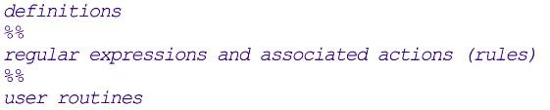
Compiler Design
How to write a Lex Specification file (*.l) ?
The Lex specification file is divided into three sections with %% dividing the sections.
The structure of a lex specification file is as follows -
Definitions include declarations of constant, variable and regular definitions.
Rules define the statement of form p1 {action1} p2 {action2}....pn {action}.
Where pi describes the regular expression and action1 describes the actions what action the lexical analyzer should take when pattern pi matches a lexeme.
User subroutines are auxiliary procedures needed by the actions. The subroutine can be loaded with the lexical analyzer and compiled separately.

Slide 8
Compiler Design Lex Specification file
Input is copied to output one character at a time.
The first %% is always required as there must always be a rules section.
However, if we don’t specify any rules, then the default action is to match everything and copy it to output.
Defaults for input and output are stdin and stdout.
Any source code not intercepted by lex is copied into the generated program.
A line that is not part of a lex rule or action, which begins with a blank or tab, is copied out as above (useful for global declarations)
Anything included between lines containing only %{ and %} (useful for preprocessor statements that must start in col.1)
Anything after the second %% delimiter is copied out after the lex output (useful for local function definitions)

Slide 9
Compiler Design Lex Specification file
Definitions intended for lex are given before the first %%. Anyline in this section that does not begin with a blank or tab, or is not enclosed by %{...%}, is assumed to be defining a lex substitution string of the form
name translation , for e.g, letter [a-zA-Z]
yytext : a character array that contains the actual string that matches a pattern.
yyleng : the no. of characters matched.
Values associated with the token are returned by lex in a union variable yylval.
Local variables can be defined.
Do not leave extra spaces and/or empty lines at the end of the lex specification file.
[0-9]+ { yylval = atoi(yytext); return INTEGER;}

Slide 10
Compiler Design
Lex Specification file - A Simple Example
https://www.epaperpress.com/lexandyacc/prl.html
Here, two patterns have been specified in the rules section.
Each pattern must begin in column one.
This is followed by whitespace (space, tab or newline) and an optional action associated with the pattern.
%%
. ECHO;
\n ECHO;
%%
int yywrap() { return 1;
}
int main(void) { yylex();
return 0;
}
The action may be a single C statement, or multiple C
statements enclosed in braces.
Anything not starting in column one is copied to the generated C file. This behavior can be to specify comments in the lex file.
In this example there are two patterns, "." and "\n", with an ECHO action associated for each pattern.

Slide 11
Compiler Design
Lex Specification file - A Simple Example (cont.)
Several macros and variables are predefined by lex.
ECHO is a macro that writes code matched by the pattern.
%%
. ECHO;
\n ECHO;
%%
int yywrap() { return 1;
}
int main(void) { yylex();
return 0;
}
This is the default action for any unmatched strings. Typically, ECHO is defined as:
#define ECHO fwrite(yytext, yyleng, 1, yyout)
Function yywrap is called by lex when input is exhausted. Return 1 if done , 0 if more processing is required.
Every C program requires a main function. In this case we simply call yylex which is the main entry-point for lex.
Some implementations of lex include copies of main and yywrap in a library thus eliminating the need to code them explicitly.

Slide 12
Compiler Design
Some predefined variables in Lex
Table : Lex Predefined Variables
Name | Function
int yylex(void) | call to invoke lexer, returns token
char *yytext | pointer to matched string
yyleng | length of matched string
yylval | value associated with token
int yywrap(void) | wrapup, return 1 if done, 0 if not done
FILE *yyout | output file
FILE *yyin | input file
INITIAL | initial start condition
BEGIN condition | switch start condition
ECHO | write matched string

Slide 13
Compiler Design
Lex Specification file - Example 2 - Line Numbers
This example prepends line numbers to each line in a file.
Some implementations of lex predefine and calculate yylineno.
%{
int yylineno;
%}
%%
(.*)\n printf("%4d\t%s", yylineno++, yytext);
%%
int yywrap() { return(1); } int main() {
yyin = fopen("input.txt", "r"); yylex();
fclose(yyin);
}
%option yylineno is added to the definitions
Check program file : start_conditions.l
Here, the input file for lex is yyin (which
defaults to stdin), which is initialised in the main function.
Variable yytext is a pointer to the matched
string (NULL-terminated) and yyleng is the
length of the matched string.
Variable yyout is the output file and defaults to stdout.
Program file - line_numbers.l

Slide 14
Compiler Design
Lex Specification file - Example 3 - Using definitions
digit [0-9] letter [_A-Za-z]
%{
#include<stdio.h>
%}
%%
{letter}({letter}|{digit})*
. ;
%%
int yywrap(){return(1);} int main()
{
This example demonstrates the use of the definitions section.
The definitions section is composed of substitutions, code, and start states.
Code in the definitions section is simply copied as-is to the top of the generated C file and must be bracketed with %{ and %} markers.
Substitutions simplify pattern-matching rules.
printf("Identifier : %s",yytext);
yyin = fopen("input.txt", "r"); yylex();
fclose(yyin); return 0;
}
Program file - identifiers.l

Slide 15
Compiler Design
Lex Specification file - Example 4 - Word count
This example counts the number of characters, words, and lines in a file (similar to Unix wc)
Whitespace must separate the defining term and the associated expression.
References to substitutions in the rules section are surrounded by braces ({letter}) to distinguish them from literals.
When we have a match in the rules section the associated C code is executed.
%{
int nchar, nword, nline;
%}
%%
\n { nline++; nchar++; }
[^ \t\n]+ { nword++, nchar += yyleng; }
. { nchar++; }
%%
int yywrap(){return(1);} int main(void) {
yyin = fopen("input.txt", "r"); yylex();
printf("%d\t%d\t%d\n", nchar, nword, nline); return 0;
}
Program file - counts.l

Slide 16
Compiler Design
Lex Specification file - Example 5 - Removing comments
This example removes single line and double line comments.
%%
\/\/(.*) ;
\/\*(.*\n*)*.*\*\/ ;
%%
int yywrap(){return(1);} int main()
{
yyin=fopen("input.txt","r"); yylex();
return 0;
}
Program file - removing_comments.l

Slide 17
Compiler Design yyparse() and yylex() https://www.ibm.com/docs/en/zos/2.4.0?topic=yacc-function-section#yacfun
yyparse() returns a value of 0 if the input it parses is valid according to the given grammar rules. It returns a 1 if the input is incorrect and error recovery is impossible.
yyparse() does not do its own lexical analysis. In other words, it does not pull the input apart into tokens ready for parsing. Instead, it calls a routine called yylex() everytime it wants to obtain a token from the input.
yylex() returns a value indicating the type of token that has been obtained. If the token has an actual value, this value (or some representation of the value, for example, a pointer to a string containing the value) is returned in an external variable named yylval.
It is up to the user to write a yylex() routine that breaks the input into tokens and returns the tokens one by one to yyparse(). See Function section for more information on the lexical analyzer.

Slide 18
Compiler Design Start conditions
Start conditions are a mechanism for conditionally activating patterns.
This is useful for handling -
Conceptually different components of an input
Situations where the lex defaults (e.g., “longest possible match”) don’t work, like in comments or quoted strings.
Declare a set of start condition names using
%Start name1 name2 . . .
If scn is a start condition name, then a pattern prefixed with <scn> will only be active when the scanner is in start condition scn.z

Slide 19
Compiler Design Start conditions
The scanner begins in start condition INITIAL, of which all non-<scn>-prefixed rules are members.
Start conditions such as these are inclusive: i.e., being in that start condition adds appropriately prefixed rules to the active rule set.
flex also allows exclusive start conditions (declared using %x), which are sometimes more convenient.
%x scn
Example - Detecting multi-line comments using start conditions Program File - start_conditions.l
This program makes use of start conditions to detect the beginning and end of a multiline comment.

Slide 20
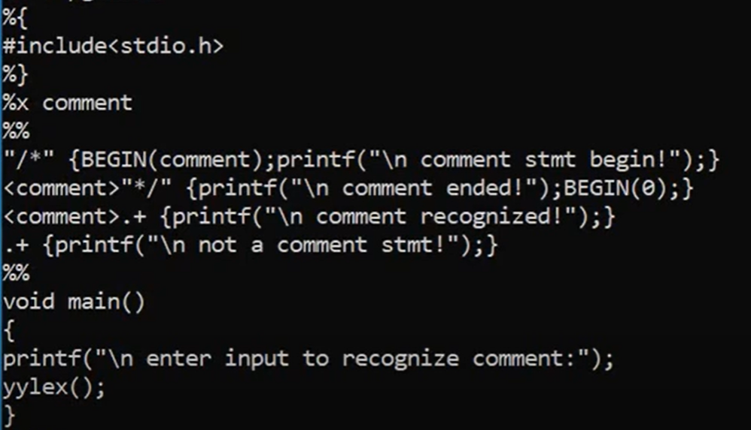
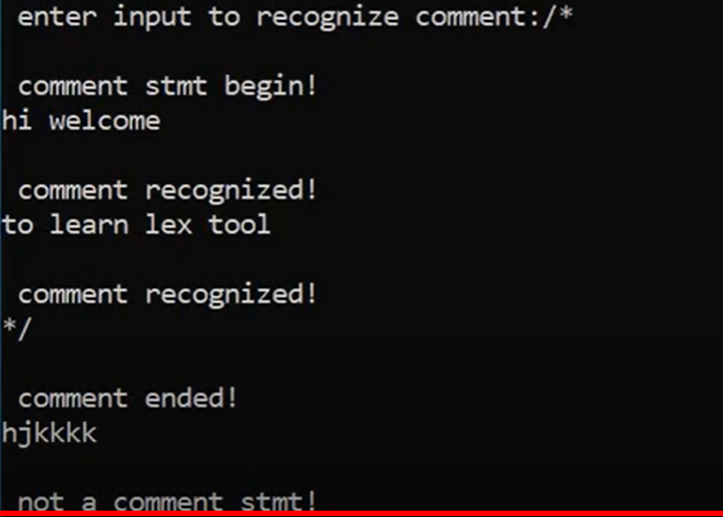
Compiler Design Example

Slide 21
Compiler Design
Commonly used Regular expressions in lex specification file
Table 1: Special Characters
Pattern | Matches
. | any character except newline
\. | literal .
\n | newline
\t | tab
\\ | matches character \
^ | beginning of line
$ | end of line

Slide 22
Compiler Design
Commonly used Regular expressions in lex specification file
Table 2: Operators
Pattern | Matches
? | zero or one copy of the preceding expression
* | zero or more copies of the preceding expression
+ | one or more copies of the preceding expression
a|b | a or b (alternating)
(ab)+ | one or more copies of ab (grouping)
abc | abc
abc* | ab abc abcc abccc ...
"abc*" | literal abc*
abc+ | abc abcc abccc abcccc ...
a(bc)+ | abc abcbc abcbcbc ...
a(bc)? | a abc

Slide 23
Compiler Design
Commonly used Regular expressions in lex specification file
Table 3: Character Class
Pattern | Matches
[abc] | one of: a b c
[a-z] | any letter a through z
[a\-z] | one of: a - z
[-az] | one of: - a z
[A-Za-z0-9]+ | one or more alphanumeric characters
[ \t\n]+ | whitespace
[^ab] | anything except: a b
[a^b] | one of: a ^ b
[a|b] | one of: a | b
https://support.workiva.com/hc/en-us/articles/4407304269204-Regular-expression-operators

Slide 24
Compiler Design
Commonly used Regular expressions in lex specification file
Pattern | Matches
[a] | a but nothing else
[ ]a] | ] or a but nothing else
[[a] | [ or a but nothing else
[ ][ ] | ] or [ but nothing else (why?)
\[ | [ (not a character class)
[-az] | - or a or z but nothing else
[az-] | - or a or z but nothing else
[ ]-az] | any character from ] to a, or z
[ ]az-] | ] or a or z or - but nothing else
[ab^] | a or b or ^ but nothing else
[ ]az^-] | ] or a or z or ^ or - but nothing else
Pattern | Matches
[^ab] | any character except a or b
[^^] | any character except ^
https://www.ics.uci.edu/~alspaugh/cls/shr/regularExpression.html

Slide 25
THANK YOU
Preet Kanwal
Department of Computer Science & Engineering
preetkanwal@pes.edu

